Slide 1

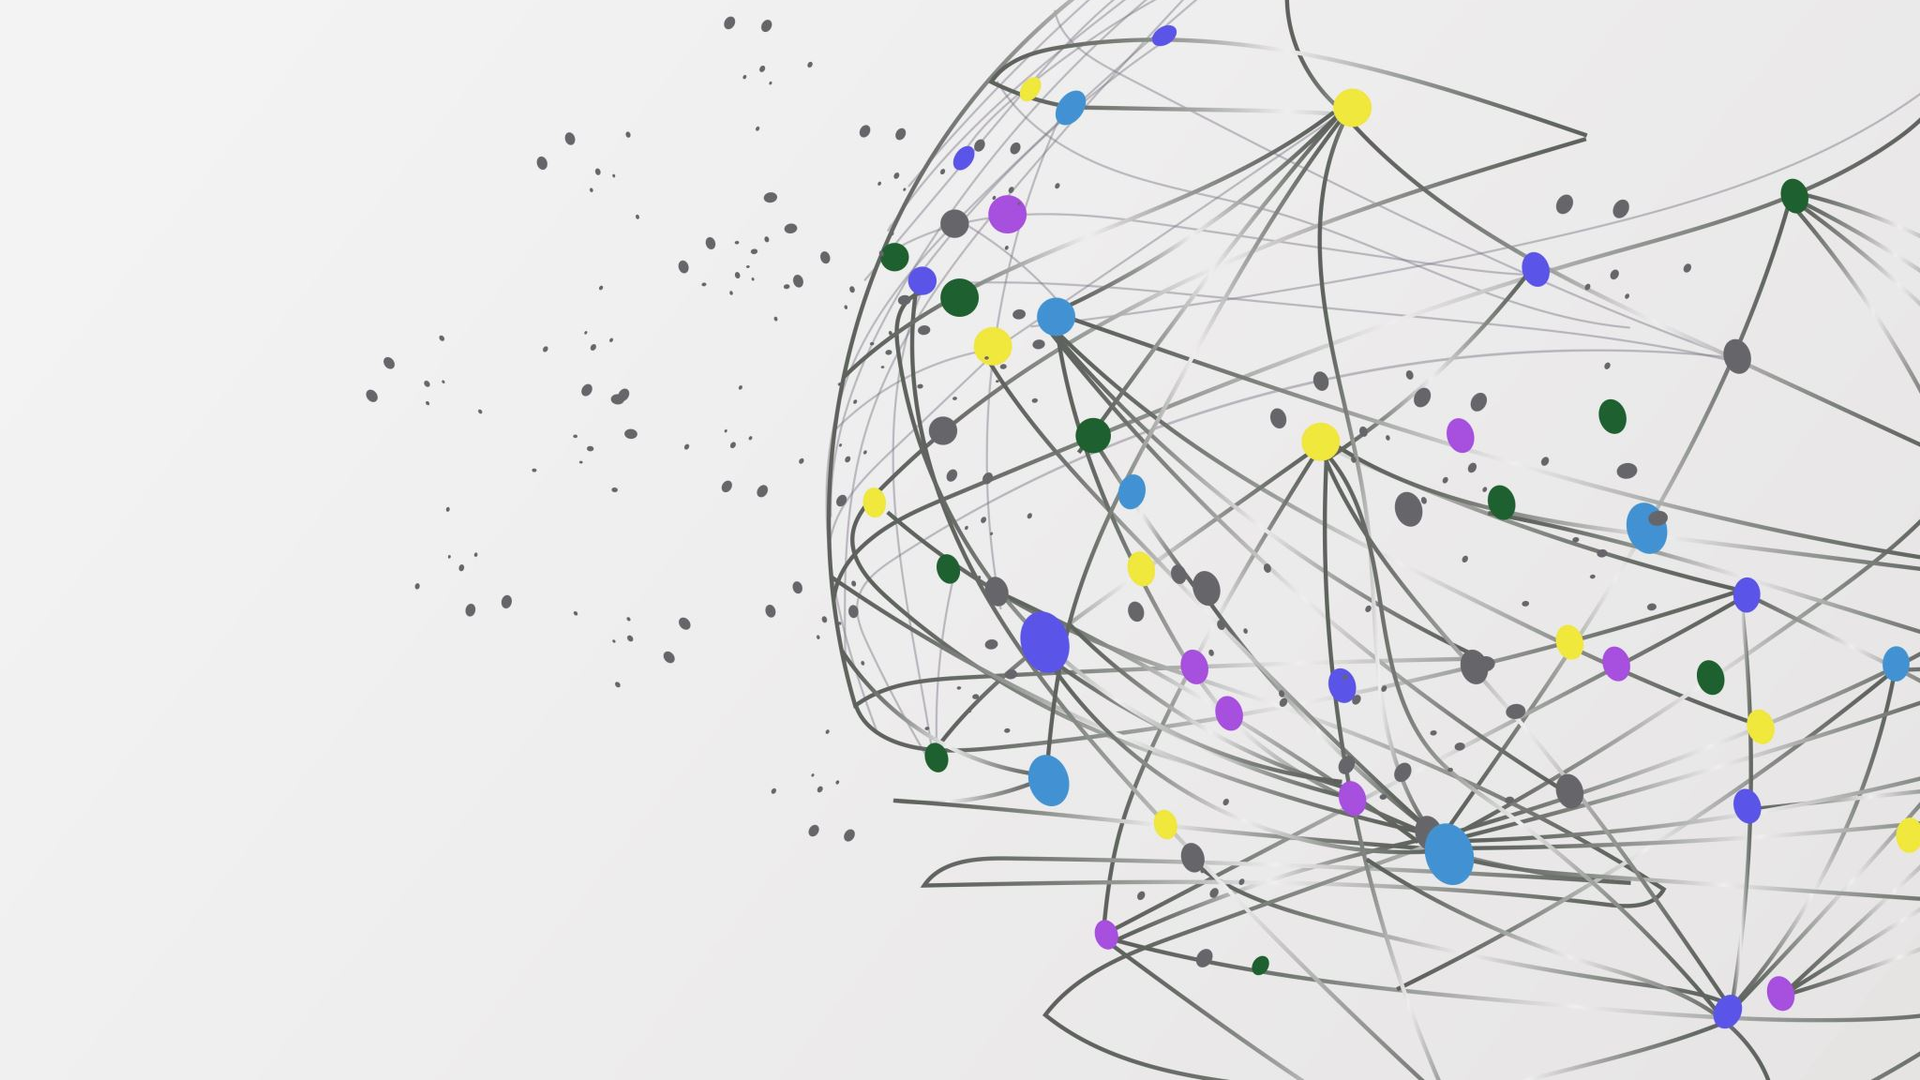
Realtime web applications
A google docs like project – by Michelle Weber Larsen & Kasper Bartholin Steenstrup Wogelius

Slide 2
Setup
To start the server, use "npm run serverStart" in the server folder (cmd, VSCode terminal or powershell)
To start client use "npm start" in client folder (cmd, VSCode terminal or powershell)
Open localhost:3000 in browser

Slide 3
NodeJS module
Mongoose
Is the way we connected to the MongoDB, we could have installed a pure MongoDB module but have worked with mongoose before, and it still connects to a MongoDB
Socket.io
Used to send data
http
Create HTTP server listening to specific port and responds to client
react-router-dom@5
Version 5 seemed to work better with switches and redirections instead of routes and navigation in version 6 and above
UUID
To create Universal Unique IDentifiers for the separate documents

Slide 4
React
Mainly used is
useCallback
only runs when one if its dependencies update.
useEffeck
Let react know the components inside needs to do something, after rendering.
useState
Used to declare state variables. Letting them be preserved after a function exits

Slide 5
MongoDB
MongoDB is used because it’s a non-relational database and since we don’t need to have our data set in the tabular schema of rows and columns, and it’s faster than a relational database.

Slide 6
Strategy
We have used git to collaborate, together with communicating what each person would do at what times.
We have mostly worked on the project while being sat at separate locations, due to time management and therefor opted out of physical meetings about this project, simply due to other projects requiring us to work on it at the exact same time, and this project did not

Slide 7
Architecture
App
Index
TextEditor
Server
document

